Slide 1



Sales Dashboard
View in Power BI
Last data refresh:
9/6/2023 2:57:25 PM UTC
Downloaded at:
9/6/2023 3:08:52 PM UTC

Slide 2
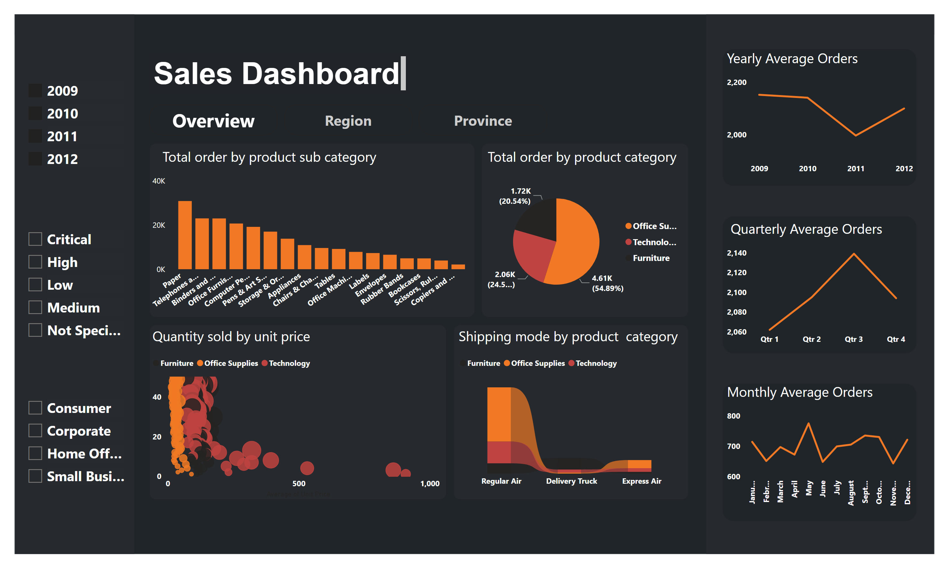
Overview
Notes:
textbox
No alt text provided
pageNavigator
No alt text provided
lineChart
No alt text provided
textbox
No alt text provided
lineChart
No alt text provided
lineChart
No alt text provided
textbox
No alt text provided
textbox
No alt text provided
columnChart
No alt text provided
pieChart
No alt text provided
scatterChart
No alt text provided
ribbonChart
No alt text provided
slicer
No alt text provided
slicer
No alt text provided
slicer
No alt text provided
textbox
No alt text provided
textbox
No alt text provided
textbox
No alt text provided
textbox
No alt text provided

Slide 3
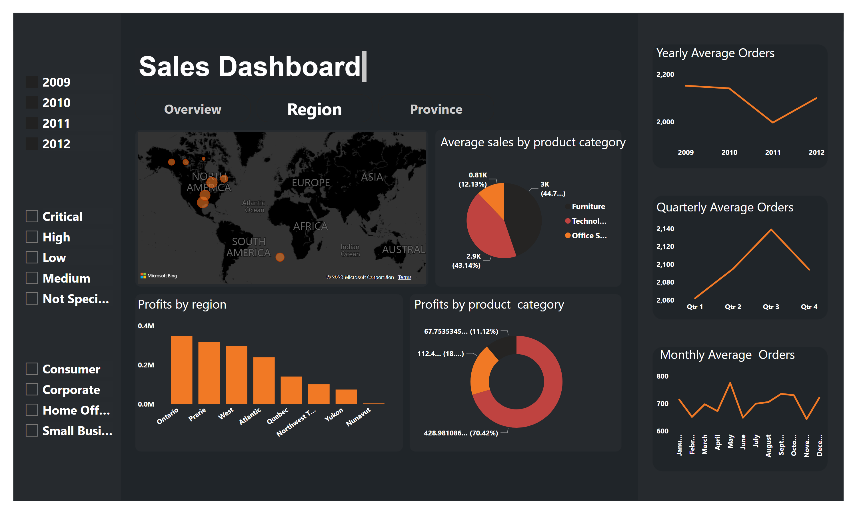
Region
Notes:
textbox
No alt text provided
pageNavigator
No alt text provided
slicer
No alt text provided
slicer
No alt text provided
slicer
No alt text provided
lineChart
No alt text provided
lineChart
No alt text provided
lineChart
No alt text provided
textbox
No alt text provided
textbox
No alt text provided
textbox
No alt text provided
map
No alt text provided
columnChart
No alt text provided
donutChart
No alt text provided
pieChart
No alt text provided
textbox
No alt text provided
textbox
No alt text provided
textbox
No alt text provided

Slide 4
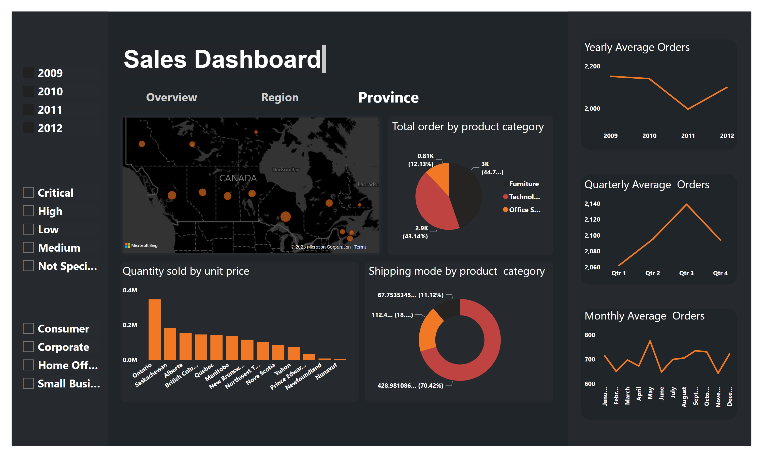
Province
Notes:
textbox
No alt text provided
pageNavigator
No alt text provided
slicer
No alt text provided
slicer
No alt text provided
slicer
No alt text provided
lineChart
No alt text provided
lineChart
No alt text provided
lineChart
No alt text provided
textbox
No alt text provided
textbox
No alt text provided
textbox
No alt text provided
textbox
No alt text provided
textbox
No alt text provided
textbox
No alt text provided
textbox
No alt text provided
columnChart
No alt text provided
map
No alt text provided
pieChart
No alt text provided
donutChart
No alt text provided

